Slide 1
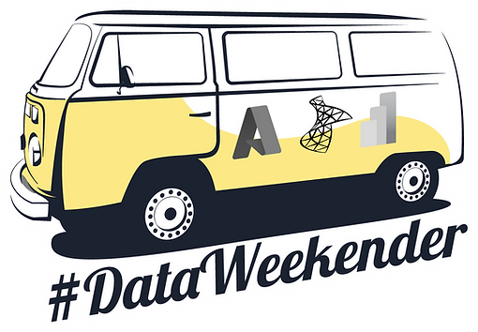

Intro to Graph Databases with Azure Cosmos DB Gremlin API
Sarah “sadukie” Dutkiewicz
Microsoft MVP, Developer Technologies
Notes:
Recommendation engines, fraud detection, social networks, IT networks... these are a few of the many applications of graph databases. Azure Cosmos DB is Microsoft's NoSQL offering, and it has an API to use Gremlin syntax for graph data. In this talk, you will get an introduction to graph data and how to query it using the Gremlin syntax.

Slide 2
Agenda
About Graph Databases
Graph Database Components
Graph Database Modeling
Azure Cosmos DB Gremlin API
Intro to Gremlin
Loading the Data
Graph Traversal

Slide 3
About Graph Databases
Exploring relationships between entities
Recommendation engines
Social networks
Symbolic reasoning
Identity and access management
Knowledge graphs
Fraud detection
Asset management
Master data management
Supply chain management
Situational awareness

Slide 4
Graph Database Components

Slide 5
Terminology
covers
Topic
Vertices – nodes - entities
Can have properties
Edges - relationships
Pay close attention to direction
Can have properties
Graph
is a
Power BI
is a
is a
SQL
Azure
You!
Interested in
contains
This talk!

Slide 6
Relationship Direction - In
Topic
Edges are going into a vertex
From the is a edge perspective, the Topic vertex is an in-vertex.
From the Topic vertex’s perspective, the is a edge is an in-edge.
is a
is a
is a

Slide 7
Relationship Direction - Out
Edges are going out of a vertex
From an is a edge’s perspective, the SQL, Azure, or Power BI vertex is an out-vertex.
From the SQL, Azure, or Power BI vertex’s perspective, the is a edge is an out-edge.
is a
Power BI
is a
is a
SQL
Azure

Slide 8
Ins and Outs - Vertexes
Topic
For these is a relationships:
Topic is the in-vertex for each edge
SQL, Azure, and Power BI are out-vertexes for each edge
is a
Power BI
is a
is a
SQL
Azure

Slide 9
Ins and Outs - Edges
For this Azure vertex:
Interested in is the in-edge
contains is the out-edge
Azure
You!
Interested in
contains
This talk!

Slide 10
Ins and Outs – All together
For this Azure vertex:
Interested in is the in-edge
contains is the out-edge
For the Interested in edge:
You! is in the out-vertex
Azure is the in-vertex
For the contains edge:
Azure is the out-vertex
This talk! is the in-vertex
Azure
You!
Interested in
contains
This talk!

Slide 11
Graph Database Modeling
Notes:
Good reference for Azure Cosmos DB specifically: Graph data modeling for Azure Cosmos DB Gremlin API | Microsoft Docs

Slide 12
covers
Understand how the data is stored for the graph database
Azure Cosmos DB stores the out-edges with their respective vertices
Identify relevant properties
Determine read and write usage overall
Useful for determining entity structure
Topic
is a
Power BI
is a
is a
SQL
Azure
You!
Interested in
contains
This talk!

Slide 13
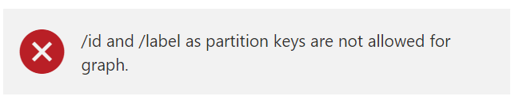
Partition Keys in Azure Cosmos DB Gremlin API
Field used for balancing data in horizontal scaling
Applies to vertices
Use a field that evenly distributes data across partitions
Read-heavy – think of your WHERE clauses
Write-heavy – think of fields with high cardinality
More guidance: Data partitioning in Azure Cosmos DB Gremlin API | Microsoft Docs
Notes:
Data partitioning in Azure Cosmos DB Gremlin API | Microsoft Docs

Slide 14
Azure Cosmos DB Gremlin API

Slide 15
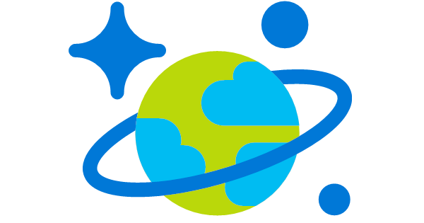

Azure Cosmos DB Gremlin API
Azure Cosmos DB is a multi-model database
Gremlin API - Graph database implementation in Azure Cosmos DB
Query in browser with Azure Data Explorer
Add to a graph with Azure Data Explorer
Build graphs with API libraries

Slide 16
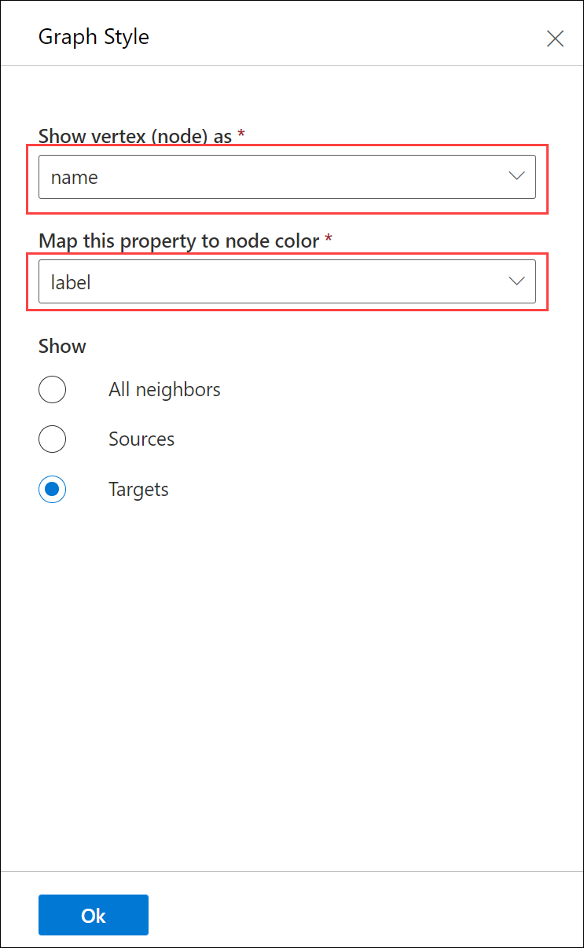
Querying in Azure Data Explorer
In the Azure Portal, select your Cosmos DB resource.
Select Data Explorer from the left side.
Select the palette icon to change the style.
Select name for the vertex
Select label for the node color.
Select Ok.

Slide 17
Demo: Azure Data Explorer

Slide 18
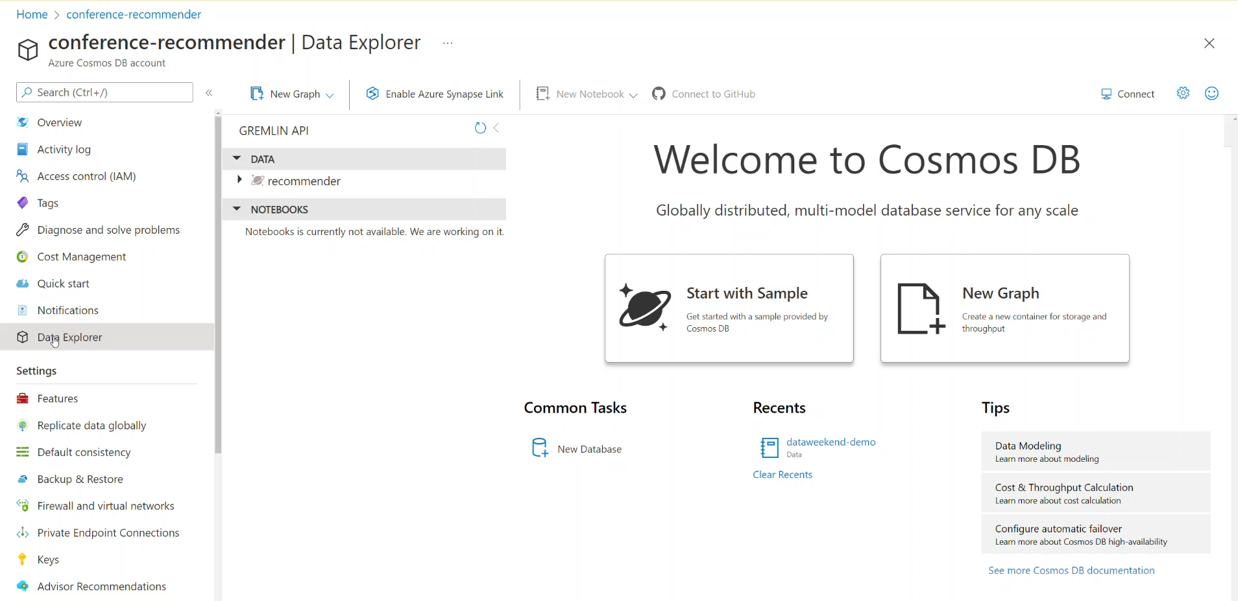

Slide 19
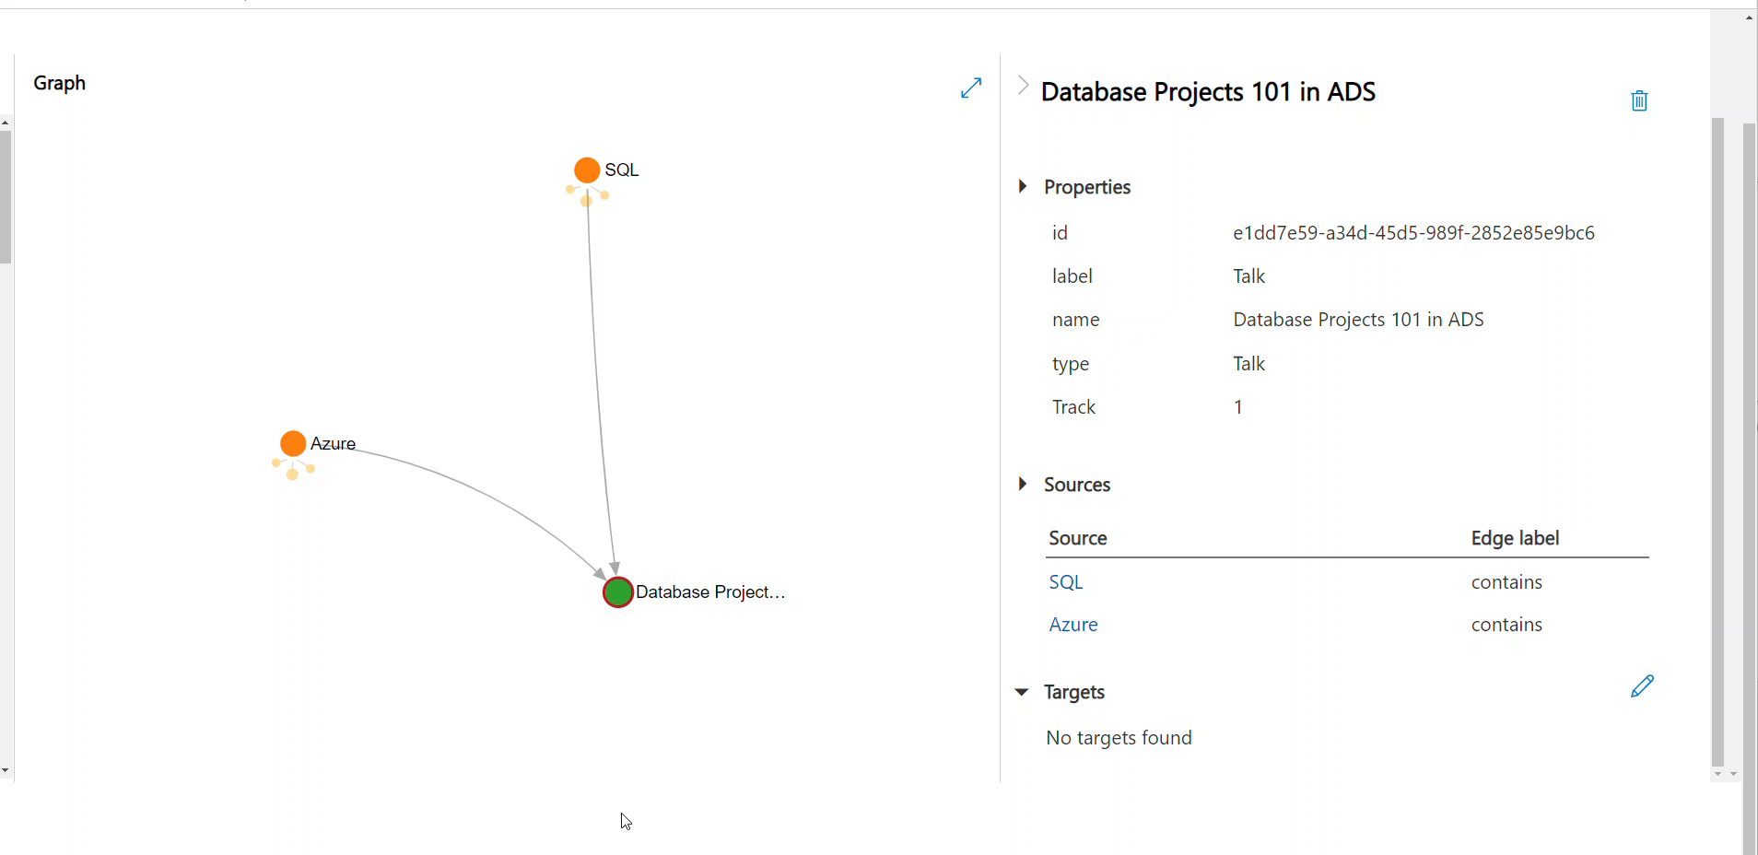

Slide 20
Gremlin

Slide 21
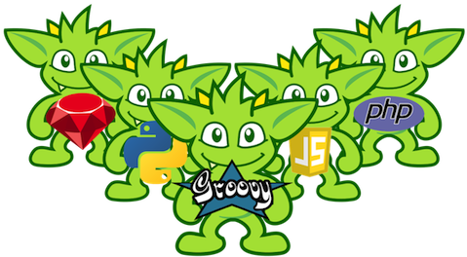
Gremlin
Comes from the Apache Tinkerpop project
Procedural
Pipeline execution
Various variants:
Gremlin-Java
Gremlin-Groovy
Gremlin-Python
Gremlin art from: Apache TinkerPop
Artist: Ketrina Yim
Gremlin-Scala
Gremlin.Net (C#)
…. and more! Check out all the Gremlin Driver Variants!

Slide 22
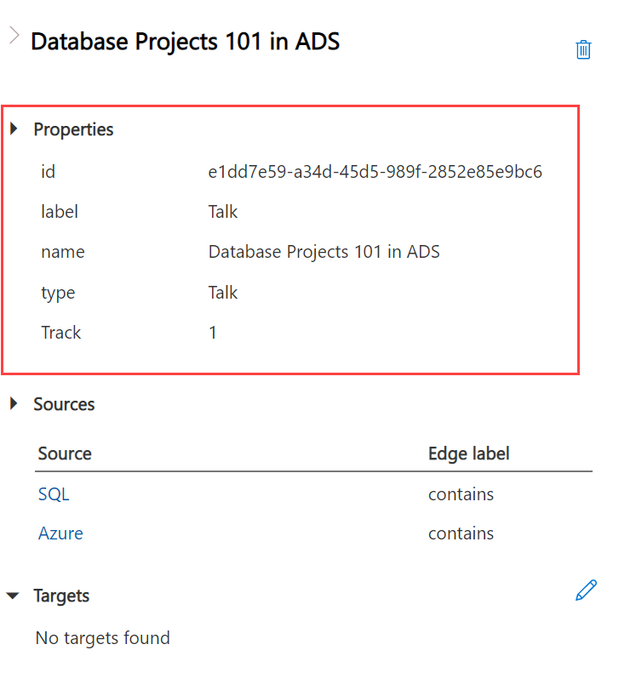
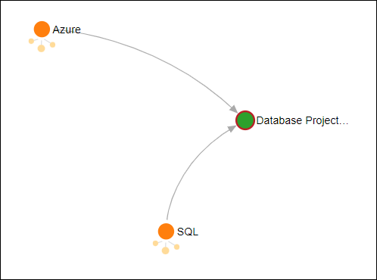
Vertices
Vertices
Command | Description
g | Get the entire graph
g.V() | Get all the vertices for the graph
g.V().hasLabel('Topic') | Get all vertices with a specific label
g.V().has('Track',2) | Get all vertices with a specific property value

Slide 23
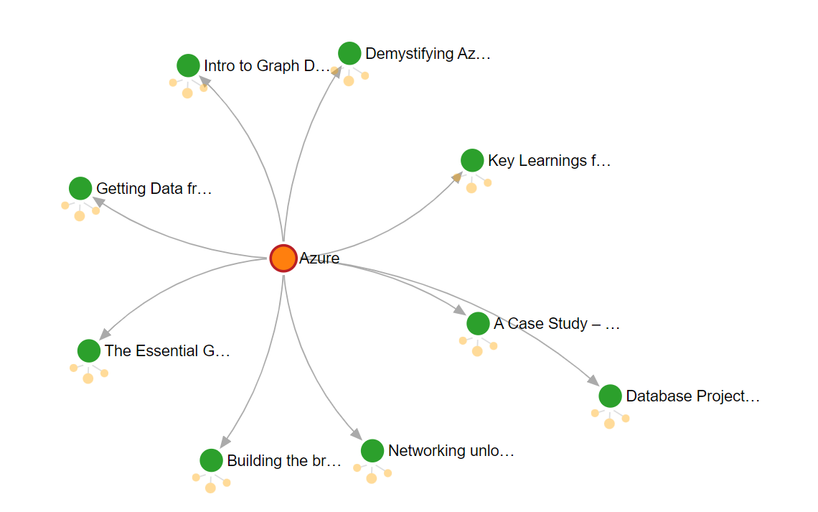
Graph Response

Slide 24
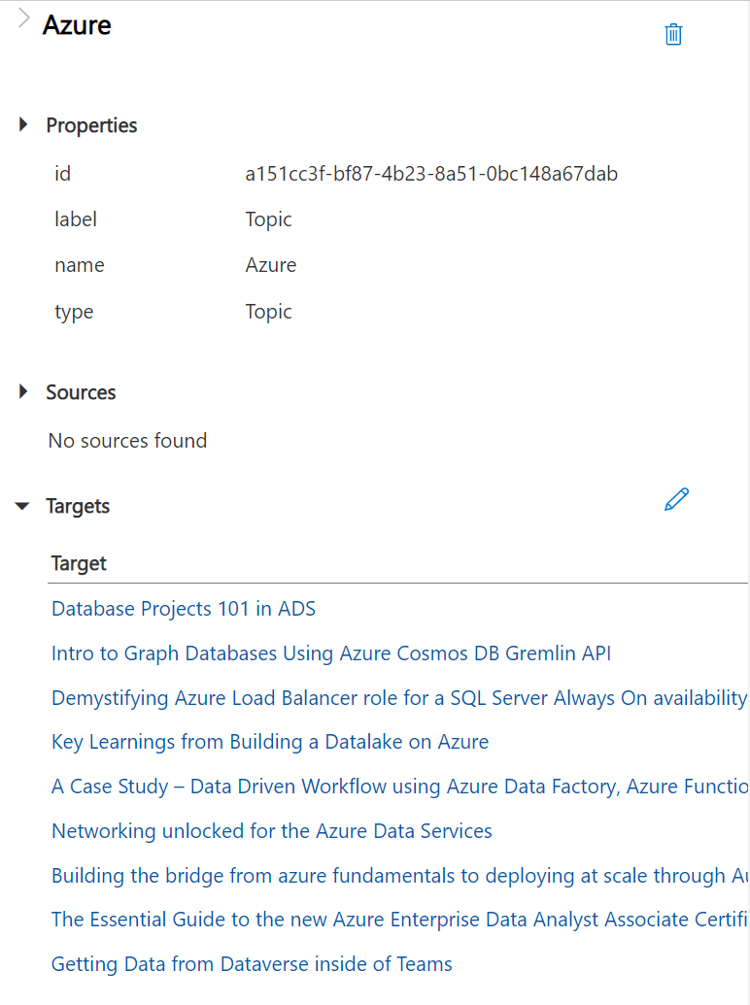
Graph Properties

Slide 25
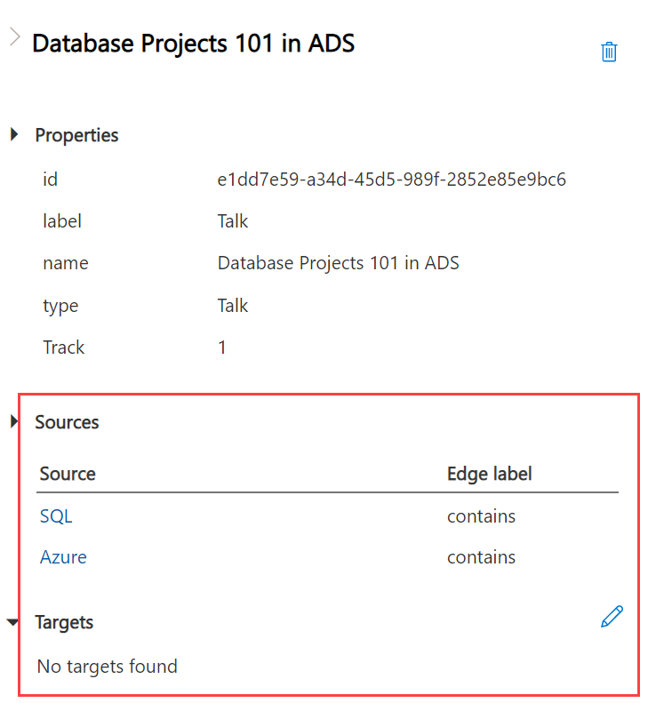
Edges
Description | Code
Graph | g
Get all edges | g.E()
Get all edges of a label | g.E().hasLabel('contains')

Slide 26
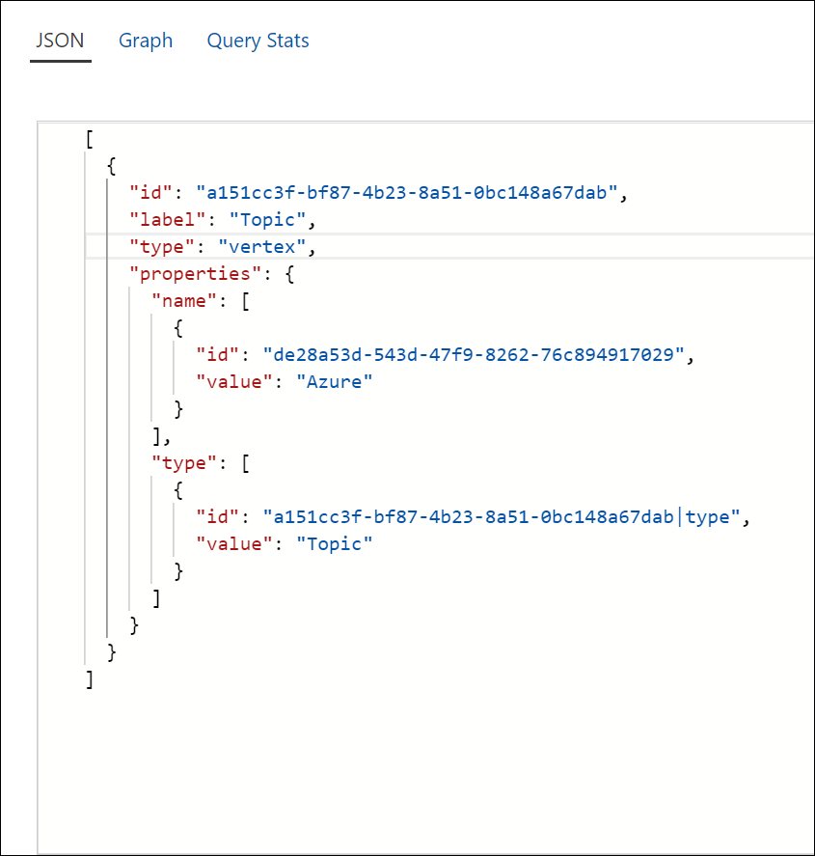
JSON Results
Available for vertices and edges
Only option for edges – there is no visual Graph option for the edges

Slide 27
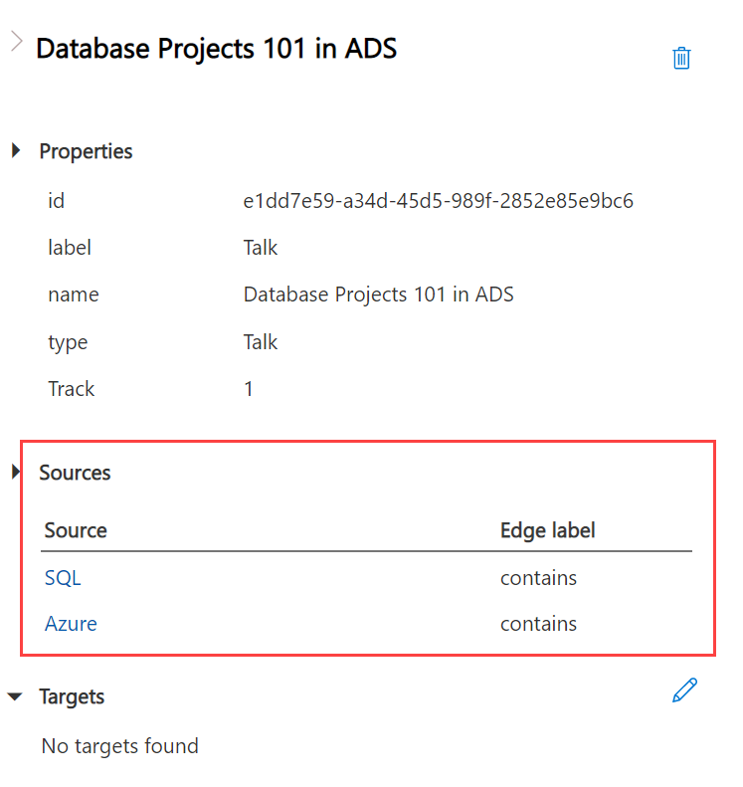
Edges as Sources

Slide 28
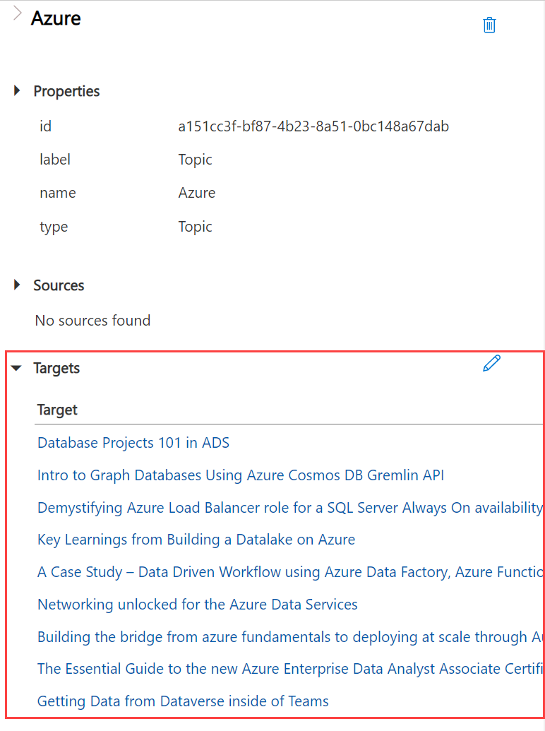
Edges as Targets

Slide 29
Loading Data

Slide 30
Steps to Load
1. Create an Azure account (or log into your existing Azure account).
2. Create a Cosmos DB Gremlin API Azure resource.
3. Add a database named recommender and a collection named dataweekender-demo with a partition key of type.
4. Download the starting Jupyter Notebook.
5. Update the connection details with your values.
6. Run the Jupyter Notebook to load the data into your Cosmos DB Gremlin API recommender.dataweekender-demo collection.
Clone the repo from GitHub at: https://bit.ly/sd-dtwkcu5

Slide 31
Loading the Database
# GraphSON V2 is called out here, as V3 is not supported yet
gremlin_client = client.Client(
'wss://' + ENDPOINT + ':443/', 'g',
username="/dbs/" + DATABASE + "/colls/" + COLLECTION,
password=PRIMARY_KEY,
message_serializer=serializer.GraphSONSerializersV2d0()
)
# Purge graph
cleanup_graph(gremlin_client)
# Insert vertices (nodes)
insert_vertices(gremlin_client)
# Insert edges (relationships)
insert_edges(gremlin_client)
Read in data using pandas in Python.
Azure Data Studio + Jupyter Notebook
Use gremlinpython to connect to Cosmos DB Gremlin API.
Create vertices for themes and episodes.
Create edges for episodes that contain themes
Can use to() and from() to build relationships. Direction matters.
Much like foreign keys in relational databases, both vertices need to exist

Slide 32
Graph Traversal

Slide 33
Graph Traversal
Gremlin is written and read left-to-right
See a statement as a pipeline
Starts with the graph as g
Navigate vertices with V and edges with E
Follow directions of relationships
In
Out
Both – gets In and Out

Slide 34
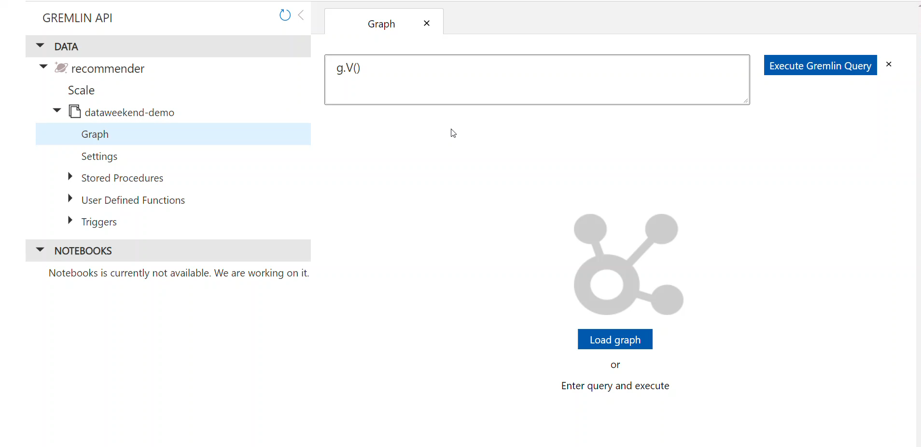
Where to Run the Queries
Azure Data Explorer
Gremlin API calls

Slide 35
Vertex Perspective
If we look at Database Projects 101 in ADS, it will have inE() because there are edges heading into it.
Pay close attention to the arrow direction.
g.V().has('name','Database Projects 101 in ADS').inE() – returns 2 edges
g.V().has('name','Database Projects 101 in ADS').outE() – returns 0 edges
If we look at Azure, it will have outE() because there are edges out of it.
Notice the arrow heading out of Azure to Data Projects in ADS.
Notes:
g.V().has('name','Colombia').outE().inV()

Slide 36
Edge Perspective
Looking at the edges from Database Projects 101 in ADS: g.V().has('name','Database Projects 101 in ADS').inE()
The inV and inVLabel are where the edge is going to – where the arrow is pointing
The outV and outVLabel are where the edge is coming from.
[
{
"id": "b39fb7ff-f3d3-41d3-80ea-8702c0663dea",
"label": "contains",
"type": "edge",
"inVLabel": "Talk",
"outVLabel": "Topic",
"inV": "e1dd7e59-a34d-45d5-989f-2852e85e9bc6",
"outV": "d4128a1f-dd06-45ac-ac88-3e71bd744c32"
},
{
"id": "4135e948-76b8-46c5-aec0-f82246e1276a",
"label": "contains",
"type": "edge",
"inVLabel": "Talk",
"outVLabel": "Topic",
"inV": "e1dd7e59-a34d-45d5-989f-2852e85e9bc6",
"outV": "a151cc3f-bf87-4b23-8a51-0bc148a67dab"
}
]

Slide 37
How many uniques?
Goal | Query | Sample Results (JSON)
Unique Labels for Vertices | g.V().label().dedup() | [ "Person", "Topic", "Conference", "Talk" ]
Unique Labels for Edges | g.E().label().dedup() | [ "contains" ]
Unique Values for a Label | g.V().hasLabel('Topic').values().dedup() | [ "Machine Learning", "Topic", "Power BI", … ]
Unique Values for a Property | g.V().hasLabel('Talk').values('Track').dedup() | [ 2, 1, 3, … ]

Slide 38
Adding Edges and Vertices
Adding a Vertex
g.addV("label").property("propName","propValue").property("prop2Name","prop2Value")
Example: Azure Cosmos DB is another theme
g.addV('Topic').property('name','Azure Cosmos DB').property('type','Topic')
Adding an Edge
Where starting from?
Where going to?
Example: The Azure Cosmos DB topic contains this talk.
g.V().has('name','Azure Cosmos DB') .addE('contains').to(g.V().hasLabel('Talk').has('name','Intro to Graph Databases Using Azure Cosmos DB Gremlin API'))

Slide 39
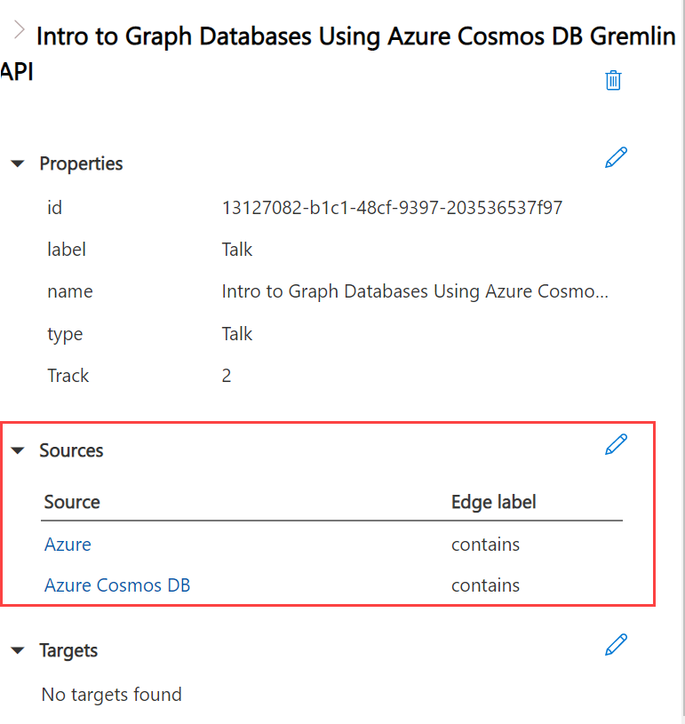
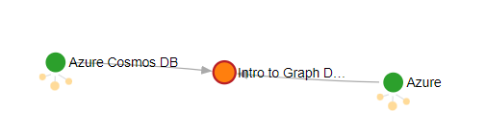
New Vertex and Edge

Slide 40
Grouping and Aggregating
Number of sessions by track:
g.V().hasLabel('Talk').group().by('Track’) .by(values('name').count())
There are 50 talks total:
g.V().hasLabel('Talk').count()
[
{
"1": 9,
"2": 7,
"3": 6,
"4": 10,
"5": 7,
"6": 11
}
]

Slide 41
Ordering
Get the talks’ name values, ordered by name:
g.V().hasLabel('Talk').order().by('name').values('name')
The first 5 talks:
g.V().hasLabel('Talk').order().by('name').values('name').limit(5)
Talks vertices ordered by track:
g.V().hasLabel('Talk').order().by('Track')

Slide 42
Filtering and Ordering
Episodes ordered by track number, then by name
g.V().hasLabel('Talk').order().by('Track').by('name’)
Track 2 talks ordered by time
g.V().hasLabel('Talk').has('Track',2).order().by('Time')

Slide 43
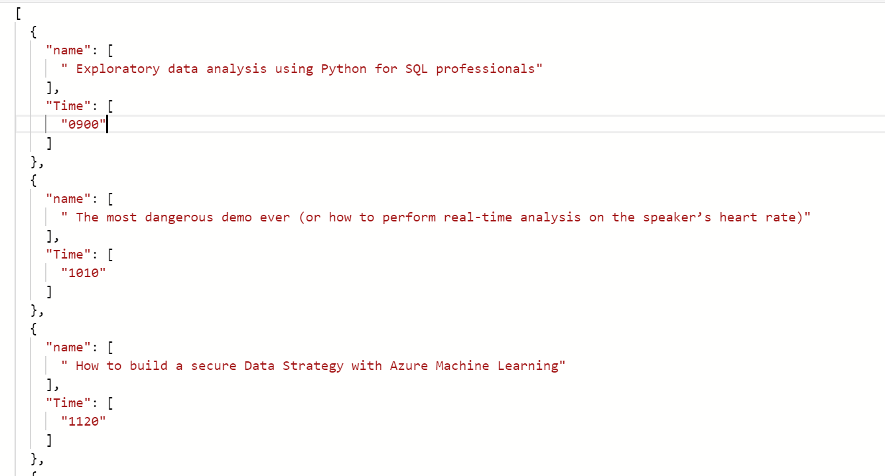
Mapping Properties and Values
g.V().hasLabel('Talk').has('Track’,2) .order().by('Time’) .valueMap('name','Time')

Slide 44
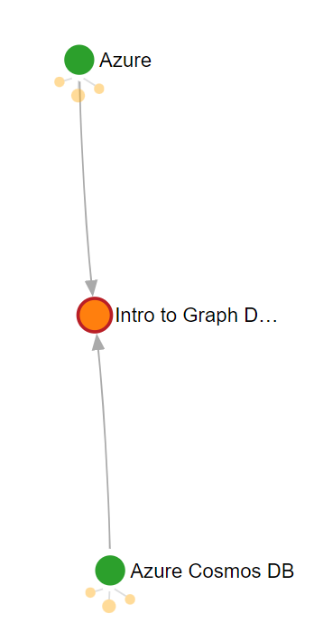
Uncovering the Path
If you like this talk, you might also like…
g.V().has('name','Intro to Graph Databases Using Azure Cosmos DB Gremlin API') .inE() .outV() .outE() .inV() .values('name')
[
"Intro to Graph Databases Using Azure Cosmos DB Gremlin API",
"Database Projects 101 in ADS",
" Demystifying Azure Load Balancer role for a SQL Server Always On availability group on Azure VMs",
" Key Learnings from Building a Datalake on Azure",
" A Case Study – Data Driven Workflow using Azure Data Factory, Azure Functions and Logic Apps",
" Networking unlocked for the Azure Data Services",
" Building the bridge from azure fundamentals to deploying at scale through Automation",
" The Essential Guide to the new Azure Enterprise Data Analyst Associate Certification",
" Getting Data from Dataverse inside of Teams",
"Intro to Graph Databases Using Azure Cosmos DB Gremlin API"
]

Slide 45
Walking the Path
Now let's look at the path:
g.V().has('name','Intro to Graph Databases Using Azure Cosmos DB Gremlin API') .inE() .outV() .outE() .inV() .values('name')
.path()

Slide 46
Connection between this talk and other talks – execution profile
[
{ "gremlin": "g.V().has('name','Intro to Graph Databases Using Azure Cosmos DB Gremlin API').inE().outV().outE().inV().values('name').executionprofile()\n",
"activityId": "fe3b3038-7a50-47e4-8d21-23800de6a0c1",
"totalTime": 29,
"totalResourceUsage": 16.99,
"metrics": [
…
]
}
]
g.V().has('name','Intro to Graph Databases Using Azure Cosmos DB Gremlin API') .inE() .outV() .outE() .inV() .values('name') .executionprofile()

Slide 47
Execution Profile Metrics
Many of these include times, counts, and storage details.
For this query:
GetVertices
GetEdges
GetNeighborVertices
GetEdges
GetNeighborVertices
ValuesOperator
ProjectOperator
g.V().has('name','Intro to Graph Databases Using Azure Cosmos DB Gremlin API') .inE() .outV() .outE() .inV() .values('name') .executionprofile()

Slide 48
Conclusion

Slide 49
Additional Resources
Azure Cosmos DB Cheat Sheets
Azure Cosmos DB Gremlin graph support and compatibility with TinkerPop features
Practical Gremlin: An Apache TinkerPop Tutorial by Kelvin R. Lawrence
Gremlin Cheat Sheet by Daniel Kuppitz

Slide 50

Thank You!
Sarah Dutkiewicz
sarah@cletechconsulting.com
Data Blog: https://data-adventurer.com
Dev Blog: https://sadukie.com
Twitter: https://twitter.com/sadukie
LinkedIn: https://linkedin.com/in/sadukie

